Slide 1




University Institute of Engineering
Department of Computer Science & Engineering
COMPUTER ORGANIZATION & ARCHITECTURE
(23CST-204/23ITT-204)
ER. SHIKHA ATWAL
E11186
ASSISTANT PROFESSOR
BE-CSE

Slide 2
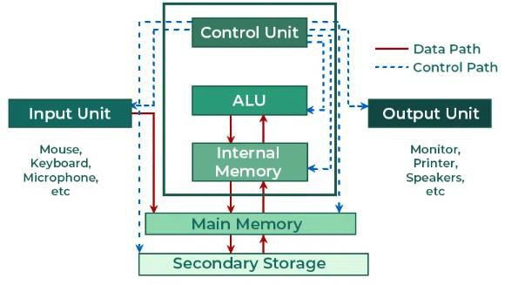
DESIGN OF CONTROL UNIT
To execute an instruction, the control unit of the CPU must generate the required control signal in the proper sequence. There are two approaches used for generating the control signals in proper sequence as Hardwired Control unit and Micro-programmed control unit.
Computer system components

Slide 3
The Control Unit is classified into two major categories:
Hardwired Control Unit
Microprogrammed Control Unit
Hardwired Control Unit
A hardwired control unit is a method of generating control signals with the help of Finite State Machines (FSM).
The control signals that are necessary for instruction execution control in the Hardwired Control Unit are generated by specially built hardware logical circuits, and we can’t change the signal production mechanism without physically changing the circuit structure.

Slide 4
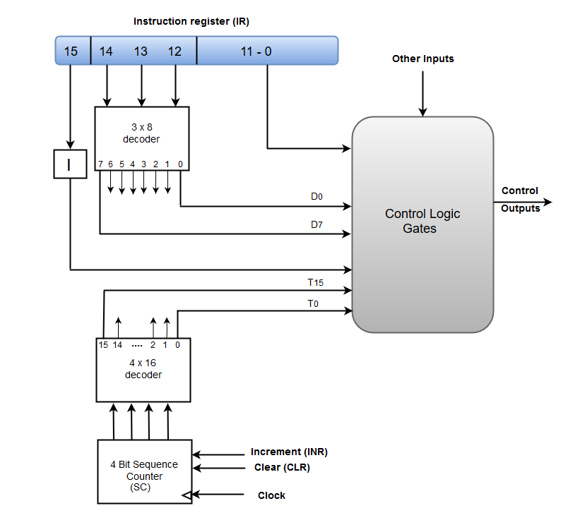
Block Diagram of Hardwired Control Unit

Slide 5
Characteristics of Hardwired Control Unit
Two decoders, sequence counter and logic gates make up a Hardwired Control.
The instruction register stores an instruction retrieved from the memory unit (IR).
An instruction register consists of the operation code, the I bit, and bits 0 through 11.
A 3 x 8 decoder is used to encode the operation code in bits 12 through 14.
The decoder’s outputs are denoted by the letters D0 through D7.
The bit 15 operation code is transferred to a flip-flop with the symbol I.
The control logic gates are programmed with operation codes from bits 0 to 11.
The sequence counter (or SC) can count from 0 to 15 in binary.

Slide 6
Designing of Hardwired Control Unit
The following are some of the ways for constructing hardwired control logic that have been proposed:
Sequence Counter Method − It is the most practical way to design a somewhat complex controller.
Delay Element Method – For creating the sequence of control signals, this method relies on the usage of timed delay elements.
State Table Method − The standard algorithmic approach to designing the Notes controller utilizing the classical state table method is used in this method.

Slide 7
Working of a Hardwired Control Unit
The basic data for control signal creation is contained in the operation code of an instruction. The operation code is decoded in the instruction decoder. The instruction decoder is a collection of decoders that decode various fields of the instruction opcode.
As a result, only a few of the instruction decoder’s output lines have active signal values. These output lines are coupled to the matrix’s inputs, which provide control signals for the computer’s executive units. This matrix combines the decoded signals from the instruction opcode with the outputs from that matrix which generates signals indicating consecutive control unit states, as well as signals from the outside world, such as interrupt signals. The matrices are constructed in the same way that programmable logic arrays are.

Slide 8
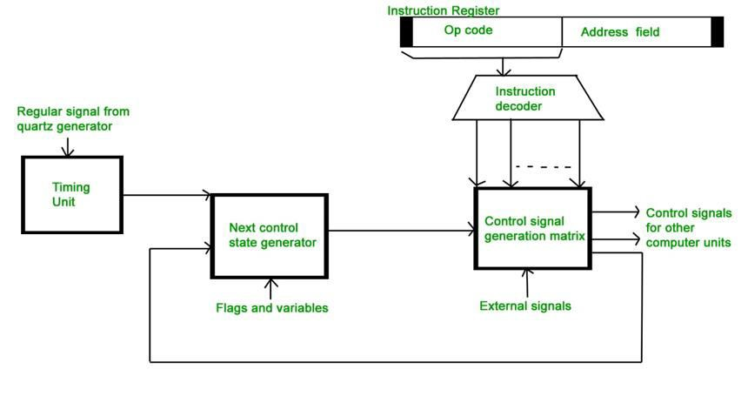
Hardwired control unit

Slide 9
Generation of a Signal
Control signals for instruction execution must be generated during the whole-time range that corresponds to the cycle of instruction execution, not just at a single moment in time.
The control unit organises the appropriate sequence of internal states based on the structure of this cycle.
The control signal generator matrix sends a number of signals back to the inputs of the following control state generator matrix. This matrix mixes these signals with the timing signals created by the timing unit depending on the rectangular patterns typically provided by the quartz generator.
The control unit is in the beginning state of new instruction, fetching whenever a new instruction arrives at it.

Slide 10
Generation of a Signal
Instruction decoding permits the control unit to enter the first state relevant to the new instruction execution, which lasts as long as the computer’s timing signals as well as other input signals, such as flags and state information, stay unchanged.
A change in any of the previously stated signals causes the control unit’s status to change.

Slide 11
Result
A new corresponding input for the control signal generator matrix is formed as a result of this. When an external signal (such as an interrupt) comes, the control unit enters the next control state, which is concerned with the response to the external signal (for example, interrupt processing). The computer’s flags and state variables are utilised to choose appropriate states for the cycle of instruction execution.
The cycle’s last states are control states that begin fetching the program’s next instruction: sending the program’s counter content to the address of the main memory buffer register and then reading the instruction word into the computer’s instruction register. The control unit enters an OS state, where it waits for the next user directive when the running instruction is the stop instruction, which terminates programme execution.

Slide 12
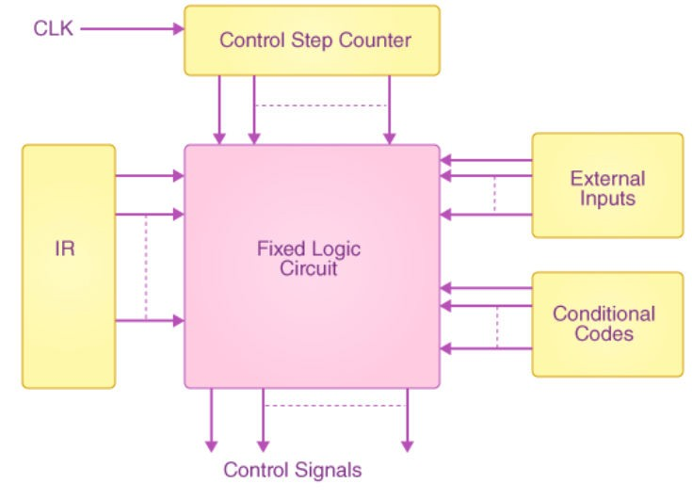

Slide 13
Advantages of Hardwired Control Unit
Hardwired Control Unit is quick due to the usage of combinational circuits to generate signals.
The amount of delay that can occur in the creation of control signals is dependent on the number of gates.
It can be tweaked to get the fastest mode of operation.
Quicker than a micro-programmed control unit.

Slide 14
Disadvantages of Hardwired Control Unit
As we require additional control signals to be created, the design becomes more complex (need for more encoders or decoders).
Changes to control signals are challenging since they necessitate rearranging wires in the hardware circuit.
It’s difficult and time-consuming to add a new feature.
It’s difficult to evaluate and fix flaws in the initial design.
It’s a bit pricey.

Slide 15
References
Reference Books:
J.P. Hayes, “Computer Architecture and Organization”, Third Edition.
Mano, M., “Computer System Architecture”, Third Edition, Prentice Hall.
Stallings, W., “Computer Organization and Architecture”, Eighth Edition, Pearson Education.
Text Books:
Carpinelli J.D,” Computer systems organization &Architecture”, Fourth Edition, Addison Wesley.
Patterson and Hennessy, “Computer Architecture”, Fifth Edition Morgaon Kauffman.

Slide 16
Reference Website:
Design of Control Unit | Computer Organization and Architecture Tutorial - javatpoint
Hardwired Control Unit | GATE Notes (byjus.com)
Reference Video Links:
https://www.youtube.com/watch?v=MxvZQLR6zqM
https://www.youtube.com/watch?v=gXXVX64yhME
https://youtu.be/1q2JKX3qg-4?si=dUjGIZjK8JVg78Xy

